Slide 1
13/3/25

Slide 2
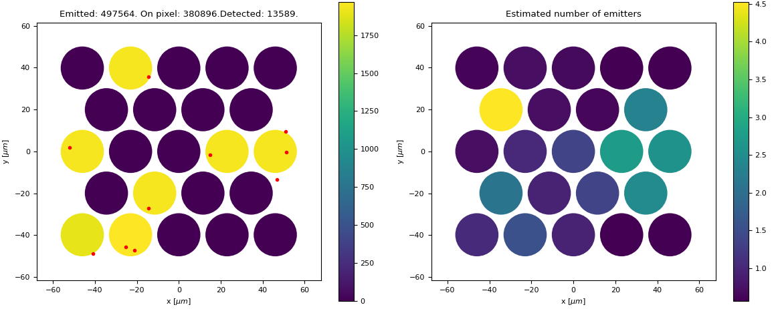
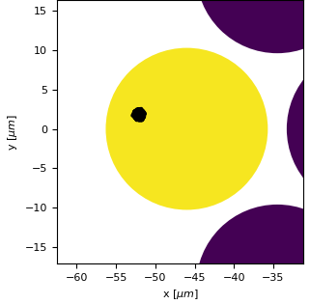
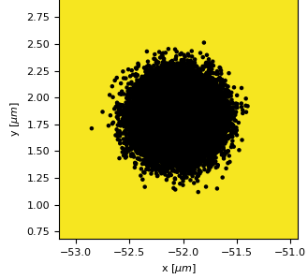
Foundation of simulations work
SPAD23

Slide 3
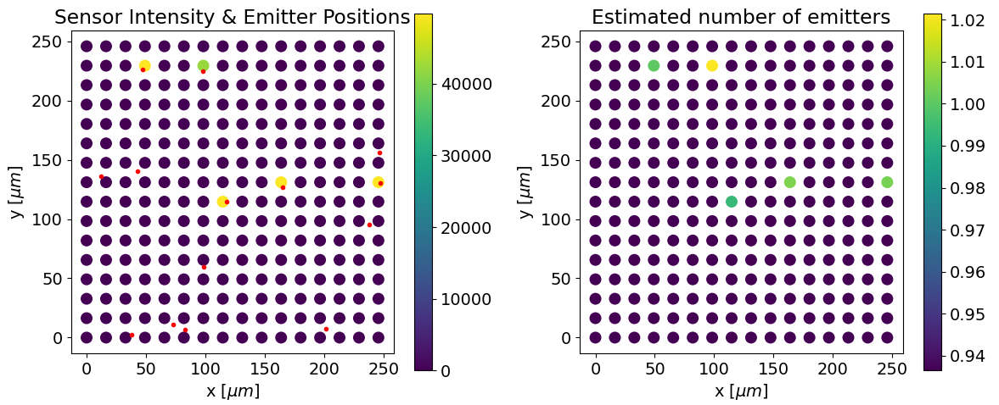
Foundation of simulations work
SPAD512

Slide 4
To do:
Implement translation from sample plane to sensor plane
Incorporate dead time, dark counts, hot pixels (we’ve seen these last two can form a challenge)
Improve weights of contributions from neighbouring pixels
Where is the pixel detection boundary?
Widefield vs scanning?

Slide 5
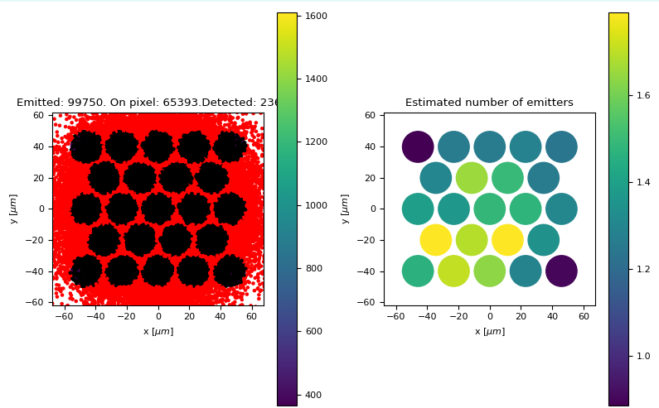
2 emitters (non widefield)

Slide 6
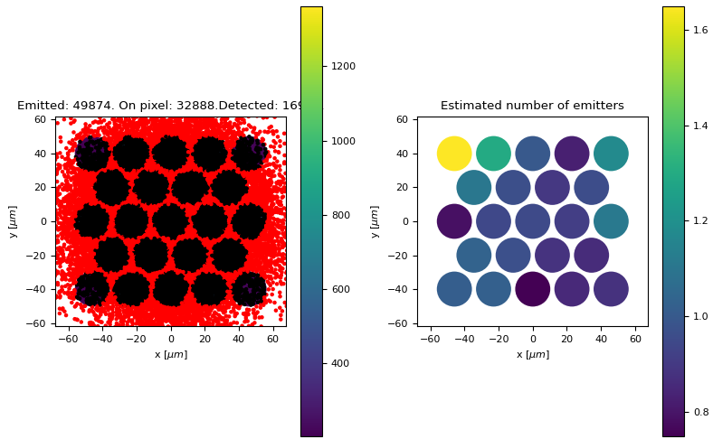
1 emitter (non widefield)

